Slide 1
Identify Characters in Authentic Materials
Day 1
Please circle the characters you recognize in the following slides, and use inference to answer questions about the materials.

Slide 2
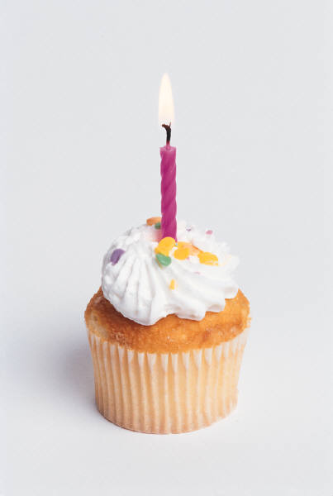
Day 1
shēngrì kuàilè
生日快乐!
张大伟的生日派对
日期：1月5号
时间：晚上6点
地点：中华路100号
人数：10－20人
请你们带另一半来参加大伟的生日派对！
认识的不认识的朋友我们都欢迎！
Step 1: Please circle the characters you know.
Step 2: Please answer the following questions:
Can you guess what the occasion is?
What does the characters ‘生日快乐’ mean?
How many people will attend the party?

Slide 3
Day 1
Step 1: Please circle the characters you know.
Step 2: Can you take a guess what the occasion is?
http://tinyurl.com/8cw9xg8

Slide 4
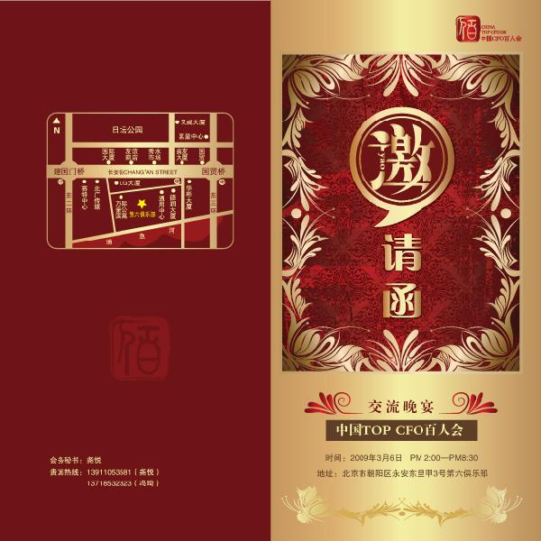
Day 1
Step 1: Please circle the characters you know.
Step 2: Can you take a guess what the occasion is?
http://www.sharejs.com/vector/chaoliu/5244

Slide 5
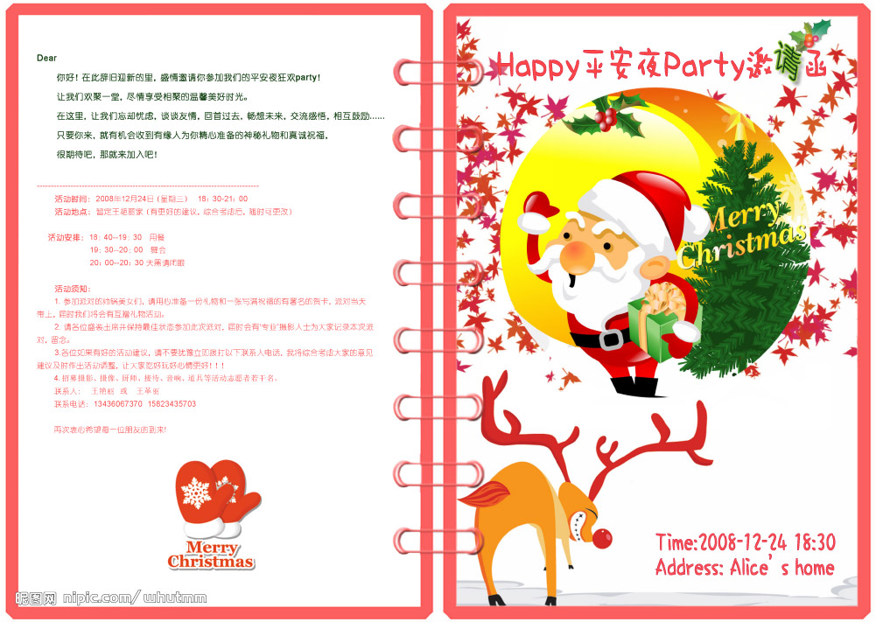
Day 1
Step 1: Please circle the characters you know.
Step 2: Can you take a guess what the occasion is?
http://pic1a.nipic.com/2009-01-08/20091822358429_2.jpg

